Slide 1

NEURAL NETWORK ANALYSIS
NUTHAN MANIDEEP KUMBHAM

Slide 2

ABSTRACT
The World Happiness Report 2015 dataset contains data on the happiness levels of people in 159 countries around the world. It includes information on a variety of factors that are thought to contribute to happiness, such as economic factors (GDP per capita), social factors (family, health, and freedom), and trust in government. The data also includes a happiness score and a happiness rank for each country. The happiness score and happiness rank are based on a poll in which people were asked to rate their overall happiness on a scale of 0 to 10. The economy, family, health, freedom, trust, and generosity columns contain various measures of those factors. Overall, the World Happiness Report 2015 dataset provides valuable insights into the factors that contribute to happiness and well-being at the national level, and can be used by researchers, policymakers, and others to better understand and promote happiness around the world.

Slide 3
DATA
.
The dataset can be found on Kaggle and it contains data on happiness levels of people in 159 countries around the world. The data is collected in the year 2015 and it includes information on a variety of factors that are thought to contribute to happiness, such as:
Column Name | Description
Country or Region | Name of the country
Happiness Score | A composite score of overall well-being
Economy (GDP per Capita) | Measure of the economic production of a country
Family | Measure of social support
Health (Life Expectancy) | Measure of the health of citizens
Freedom | Measure of freedom to make life choices
Generosity | Measure of generosity of citizens
Trust (Government Corruption) | Measure of trust in government

Slide 4
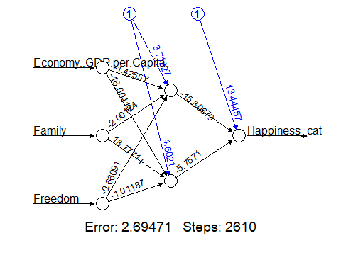
1 HIDDEN LAYER AND 2 NEURONS
The first model that is being constructed is a neural network with one hidden layer containing two neurons.
The features used for this model will include Economy, GDP per Capita, Family, and Freedom

Slide 5
CONFUSION MATRIX OF MODEL-1
The confusion matrix of model-1 for training data is given below:
 | Predicted Negative (0) | Predicted Positive (1)
Actual Negative (0) | 46 | 5
Actual Positive (1) | 3 | 40
The model's accuracy is 79.6875%.
The confusion matrix of model-1 for validation data is given below:
 | Predicted Negative (0) | Predicted Positive (1)
Actual Negative (0) | 28 | 6
Actual Positive (1) | 7 | 23
The model's accuracy is 91.48936%.

Slide 6
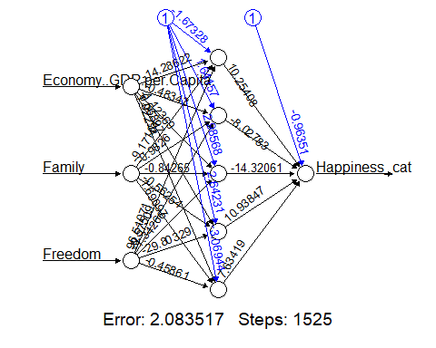
1 HIDDEN LAYER AND 5 NEURONS
The Second model that is being constructed is a neural network with one hidden layer containing five neurons.
The features used for this model will include Economy, GDP per Capita, Family, and Freedom.

Slide 7
CONFUSION MATRIX OF MODEL-2
The confusion matrix of model-2 for training data is given below:
 | Predicted Negative (0) | Predicted Positive (1)
Actual Negative (0) | 46 | 5
Actual Positive (1) | 3 | 42
The model's accuracy is 93.62%.
The confusion matrix model-2 for validation data is given below:
 | Predicted Negative (0) | Predicted Positive (1)
Actual Negative (0) | 25 | 7
Actual Positive (1) | 20 | 22
The model's accuracy is 73.4375%.

Slide 8
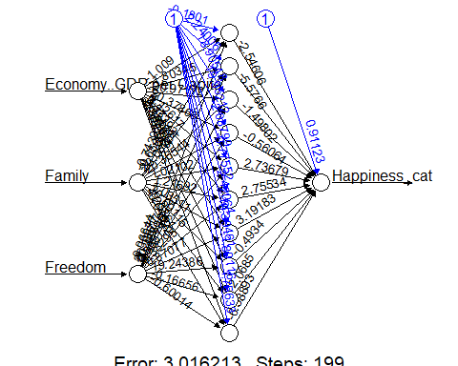
1 HIDDEN LAYER AND 10 NEURONS
The Third model that is being constructed is a neural network with one hidden layer containing ten neurons.
The features used for this model include Economy, GDP per Capita, Family, and Freedom

Slide 9
CONFUSION MATRIX OF MODEL-3
The confusion matrix of model-3 for training data is given below:
 | Predicted Negative (0) | Predicted Positive (1)
Actual Negative (0) | 46 | 7
Actual Positive (1) | 3 | 38
The model's accuracy is 89.3617%.
The confusion matrix model-3 for validation data is given below:
 | Predicted Negative (0) | Predicted Positive (1)
Actual Negative (0) | 30 | 6
Actual Positive (1) | 5 | 23
The model's accuracy is 82.8125%.

Slide 10
BEST MODEL
The analysis reveals that among the three constructed models, the neural network model with a single hidden layer and 10 neurons stands out as the best performer.
When applied to the validation data, this model demonstrates the highest accuracy, with a value of 0.828125. In order to validate the model's performance further, the data has been scaled using the features of this top-performing model.
This additional step ensures that the observed high accuracy is not merely due to chance, but rather indicates that the model is able to generalize effectively to previously unseen data.
By utilizing the features of the best model for data scaling, it provides additional evidence of the model's robustness and reliability in making accurate predictions beyond the training data.

Slide 11
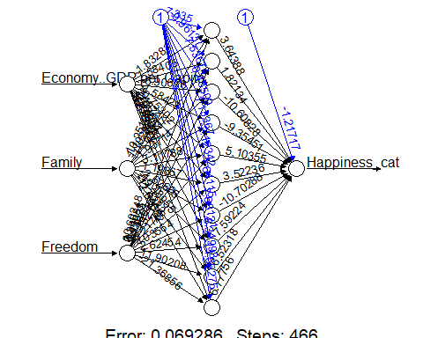
BEST MODEL- 1 HIDDEN LAYER AND 10 NEURONS (SCALED )
The features in this model include :
Economy
GDP per Capita
Family
Freedom

Slide 12
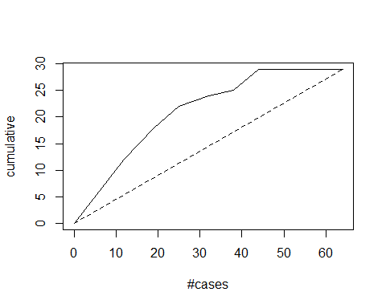
GAINS PLOT FOR BEST MODEL
The gains plot demonstrates a direct proportionality between the area enclosed by the dotted line (representing random sample selection) and the model curve. A larger area signifies superior model performance.
This plot serves as a visual tool to effectively represent the predictive power of the model and enables straightforward comparison across multiple models. It aids in identifying the significant features that impact happiness prediction and also assesses how well our model performs relative to a random sample selection.
These insights are invaluable in gauging the accuracy and efficacy of our model in predicting happiness levels.

Slide 13
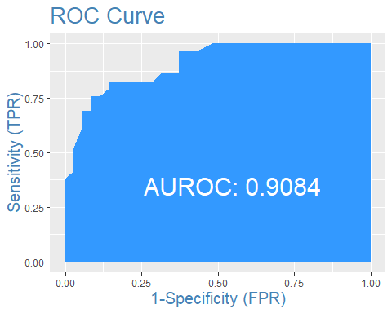
ROC CURVE FOR BEST MODEL
The AUROC (Area Under the Receiver Operating Characteristic) value of the curve is calculated to be 0.9084. This numerical metric represents the performance of the model in terms of its ability to correctly classify samples. A higher AUROC value, such as 0.9084, indicates better discriminatory power of the model in distinguishing between positive and negative samples. This value provides a quantitative measure of the model's performance and can be used to compare different models. In this case, a AUROC value of 0.9084 suggests that the model has a high level of accuracy and effectiveness in its classification task, further supporting its predictive power in the given context.

Slide 14
CONCLUSION
After thorough analysis of all the models, it can be concluded that the neural network model with features Economy, GDP per Capita, Family, and Freedom, and 1 hidden layer with 10 neurons, performs the best.
This model achieves an accuracy of 0.703125, sensitivity of 0.6667, and specificity of 0.7353 based on the evaluation results. Notably, the standardization of the data does not impact the accuracy of the validation data, indicating the model's robustness to changes in feature scale.
This suggests that the model is likely to exhibit good performance on unseen data and can be relied upon for practical use.

Slide 15

THANK YOU!

